Slide 1

ORPHANAGE
MANAGEMENT
SYSTEM
COURSE:PFSD
Under the guidance of
MADHU PRIYA Mam

Slide 2
TEAM MEMBERS
ROLL NUMBER
NAME
2110030087
P.Sravya
2110030088
T.Niharika
2110030165
B.Lahari
2110030178
Ch.Jayasree

Slide 3
INTRODUCTION
WHAT IS ORPHANAGE MANAGEMNT SYSTEM?
A system designed to keep records of Orphans in the Orphanage home.
The system comprises the create a new user and log in, Orphan’s basic details, medical information, and a search bar to easily find a particular Orphan.
Orphanage Information System is keen on the management of orphanage homes, they are the most valued or important records of orphans, and their transactions are needed to be kept for future reference.

Slide 4
PROBLEM STATEMENT
An orphanage is a place where children without parents care.
The orphanage management system manages the records, planning, and budgeting for the children in the orphanages.
Integrity, transparency, and accountability on these records become a major issue if the records are altered.
There are also circumstances where children are lost and then accommodated in the orphanages.

Slide 5
LITERATURE REVIEW
Existing method:
In the old process of adoption and donation donor have undergone many manual processes
Prospective adoptive parents need to register with an authorized agency
Home study and the child
Filling of the petition
Acceptance of the child
Pre-adoption foster care
Referral of the child
Court hearing
Court order
Follow up

Slide 6
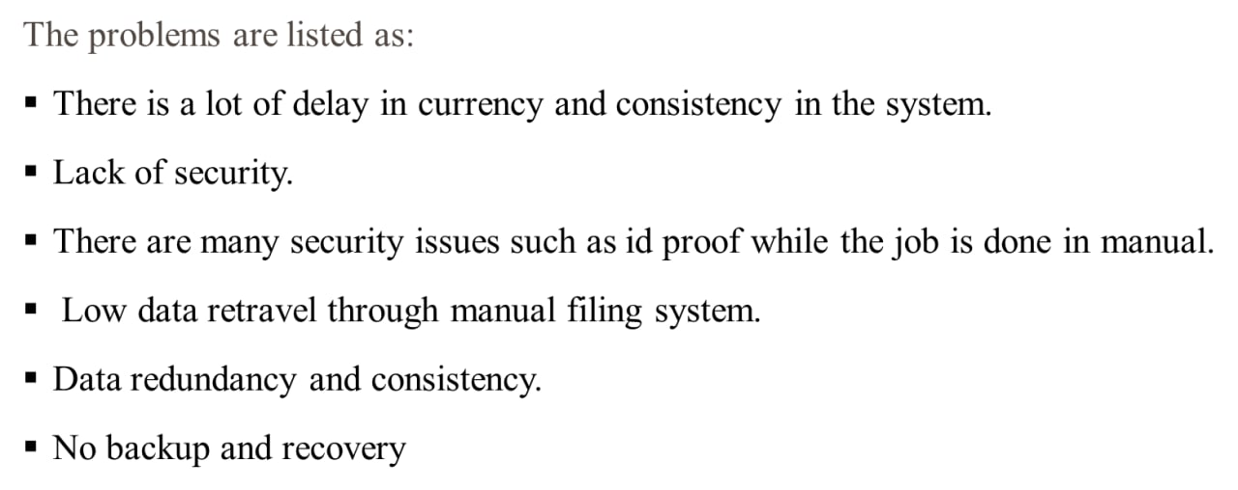
PROBLEMS IN PRESENT EXISTING SYSTEM

Slide 7
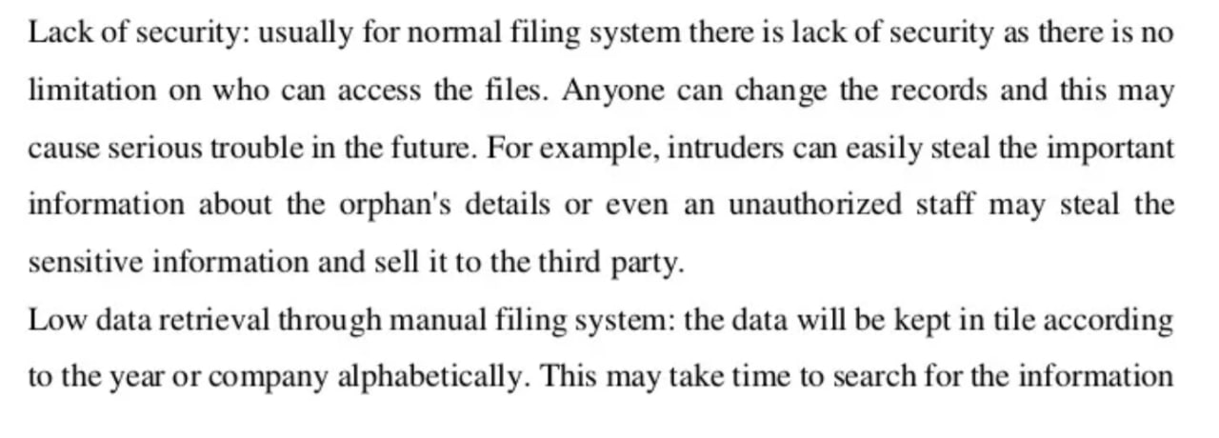
PROOFS SUPPORTING PROBLEMS IN PRESENT EXISTING SYSTEM

Slide 8
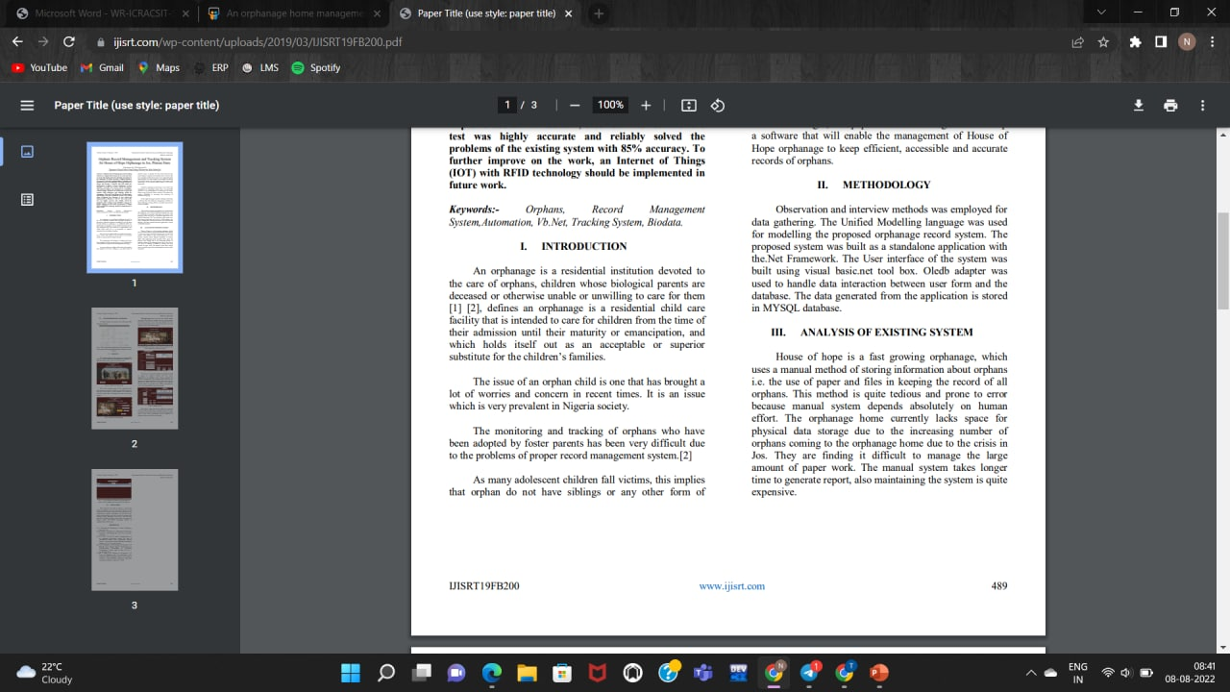

Slide 9
PROPOSED ALGORITHM
As Orphanages are increasing day to basis simultaneously the helping hands are also increasing in the higher range.
The practical difficulty is finding out the real orphans and less knowledge about the donation details.
So we are developing an Application to help to reach the needy orphans by volunteer donations.
It allows the users to search and find the orphanages on the internet and then they can donate to the orphanages whichever they want.
Motive of our paper is to eliminate the drawback of the previous application and to help orphans to the full extent.

Slide 10
PROJECT REQUIREMENTS
SOFTWARE REQUIREMENTS:
Front End: PYTHON USING DJANGO
Back End: DATABASE- MYSQL
Control End: SOFTWARE ENGNEERING

Slide 11
System Modules
Admin
Login
Add Orphanage
Name , No of people, Manager , contact, email, Bank details , Image, Google map , Address, City, District, State, Pincode.
View Orphange
Edit/Delete Orphange
Upload Images
Update Google geo location

Slide 12
MODULES DESCRIPTION:
There are two logins
One is for orphanage admin and another one is users.
Each orphanage admin and users should do the registration process.
Login process is done with the registered phone number and password.
Information about orphanages
Full details of the orphanages with contact and location details.

Slide 13
A . Registration:
In the registration page, the users should fill the registration form by giving their name, phone number, email id, and password.
We will save all these details in our database.
B . Welcome page:
After logging in to the user login, there arises Welcome!!!
Page which comprise of three options- Donation, Adoption, Details of Orphanages in different location.
C . Donation:
Donation page comprises of three options- food donate, clothes donate, and fund transaction.
D . Orphanage details:
This module comprises of the detailed information of the orphanages.
The list of different orphanages with their location is displayed here.

Slide 14
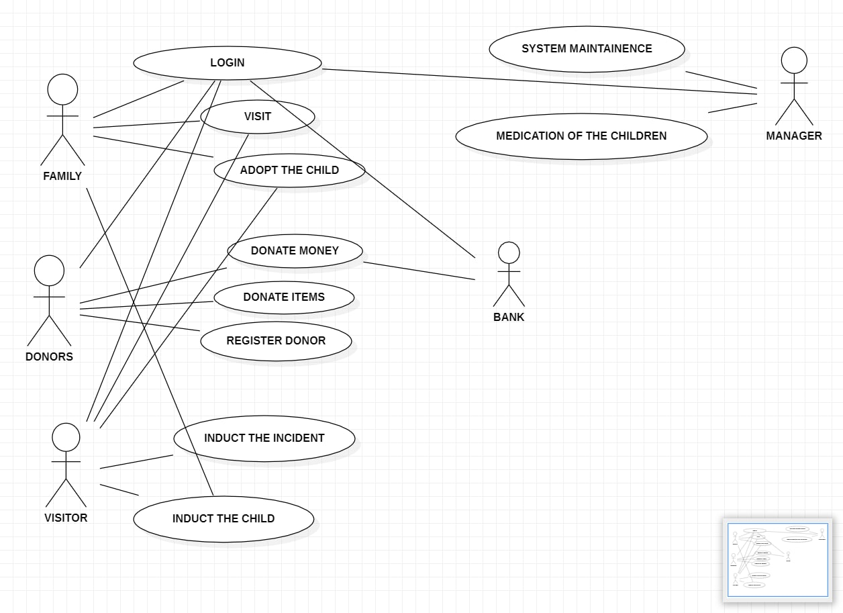
USE CASE DIAGRAM

Slide 15
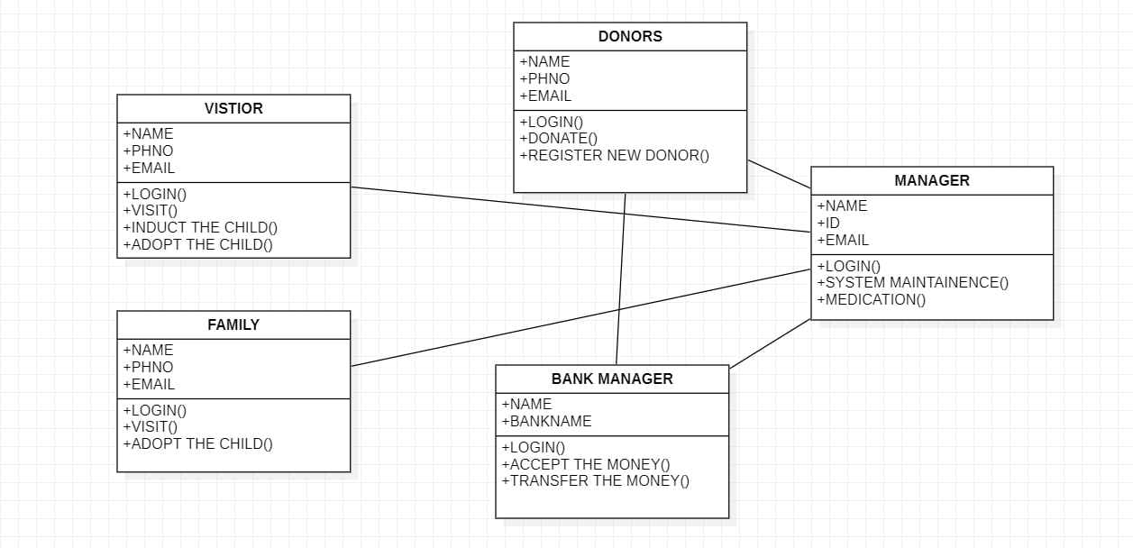
CLASS DIAGRAM

Slide 16
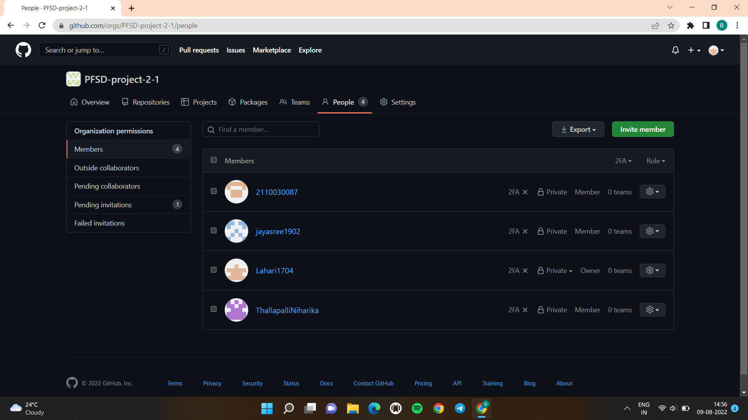
GITHUB SETUP
https://github.com/PFSD-project-2-1

Slide 17
https://github.com/ThallapalliNiharika
https://github.com/Lahari1704
https://github.com/2110030087
https://github.com/jayasree1902
GITHUB LINKS

Slide 18
DATA SET COLLECTION
We have done research on various orphanages and found that they are facing issues in maintaining the records and administering them.
So we decided to collect the data from the orphanages, conduct surveys and develop this system.
So this may help orphans to the full extent.
This makes it easier for them to help the visitors and carry out their work comfortably.

Slide 19
TOOLS REQUIRED
FLOW CHARTS
CASE STUDIES
CHECKLISTS
INTERVIEWS
OBSERVATION AND
SURVEYS OR QUESTIONNAIRES
DJANGO
USECASE DIAGRAMS
CLASS DIAGRAMS
PERSPECTIVE METHODS
Are the tools required for the collection of data in different ways based on different purposes .

Slide 20
WORK ALLOCATION TO TEAM MEMBERS
S.NO | NAME | ROLL NO | WORK ALLOCATION
1 | SRAVYA | 2110030087 | RESEARCH&PPT
2 | NIHARIKA | 2110030088 | RESEARCH&PPT
3 | LAHARI | 2110030165 | RESEARCH&PPT
4 | JAYASREE | 2110030178 | RESEARCH&PPT

Slide 21
REFERENCES
https://codeshoppy.com/shop/product/orphanage-management-system/
https://www.researchgate.net/publication/328225350_Design_and_Development_of_an_Orphans_Record_System

Slide 22
THANK YOU

